Slide 1
Battle of the Neighbourhoods
Identifying a suitable location to open a Yoga Studio in Toronto City

Slide 2
Business Problem
Yoga is an increasingly popular activity with a number of health benefits
Asked by client to recommend a suitable location for a new Yoga Studio in Toronto
New York City to be used as a similar city to base the analysis on

Slide 3
Methodology
New York City and Toronto City data imported and converted to Pandas dataframe
Foursquare API used to locate existing Yoga Studios in New York City
Studios located on map using Folium
Rating of a chosen Yoga Studio determined by using Foursquare API
K-means clustering used to identify most common venues in New York City neighbourhoods

Slide 4
Findings from New York City analysis
New York City search narrowed down to one neighbourhood, Marble Hill, with a Yoga Studio there identified as having an 8.9 rating
K-means clustering showed Yoga Studio as 3rd most common venue in this neighbourhood. Tennis Court appeared as number 5
Decided to locate an area in Toronto with existing an Tennis Court but currently no Yoga Studio
Likely that Yoga members will engage in other recreational activities such as tennis

Slide 5
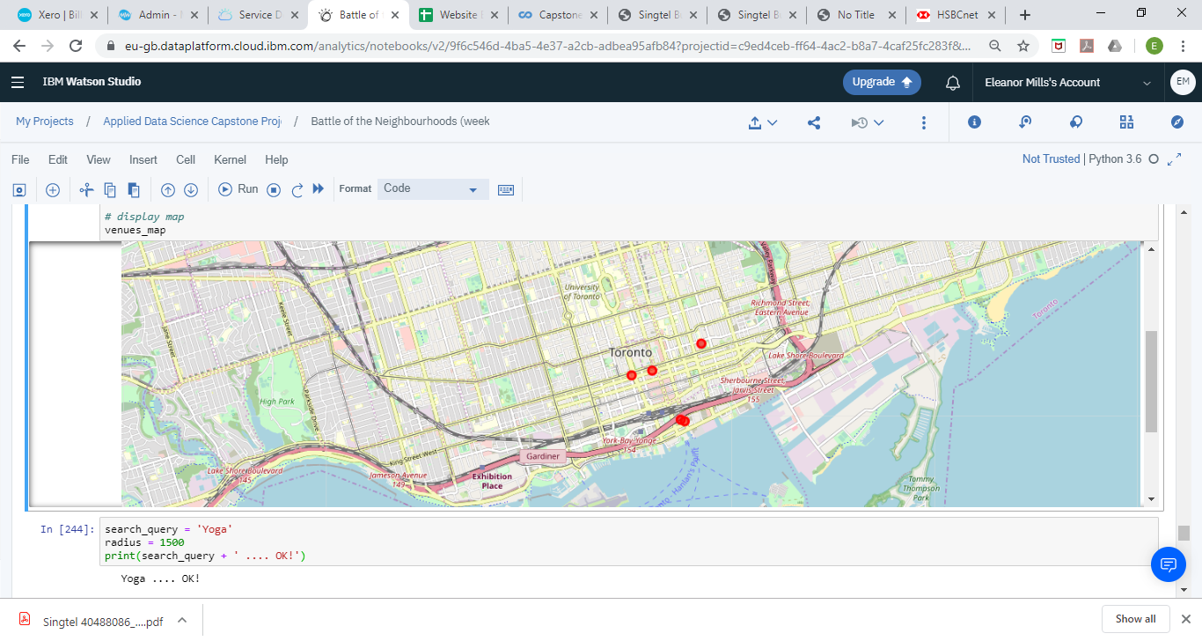
Results – Toronto city
The following Tennis Courts were found in Toronto using Foursquare API:

Slide 6
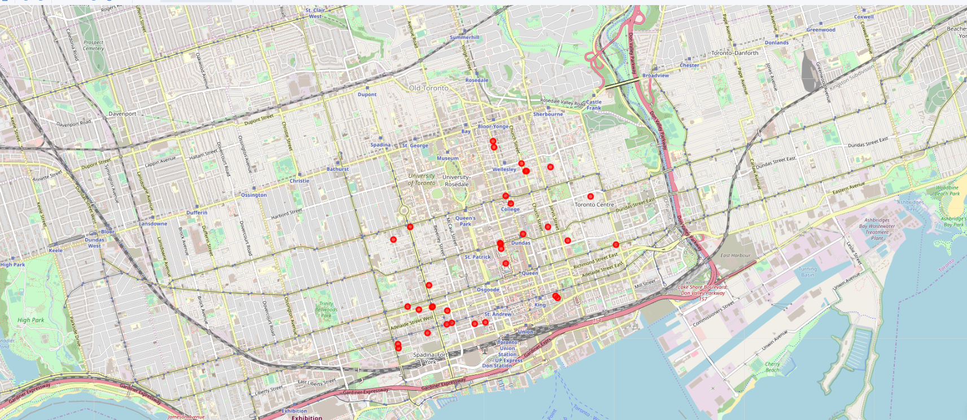
Results – Toronto city (cont)
The following Yoga Studios were found in Toronto using Foursquare API:

Slide 7
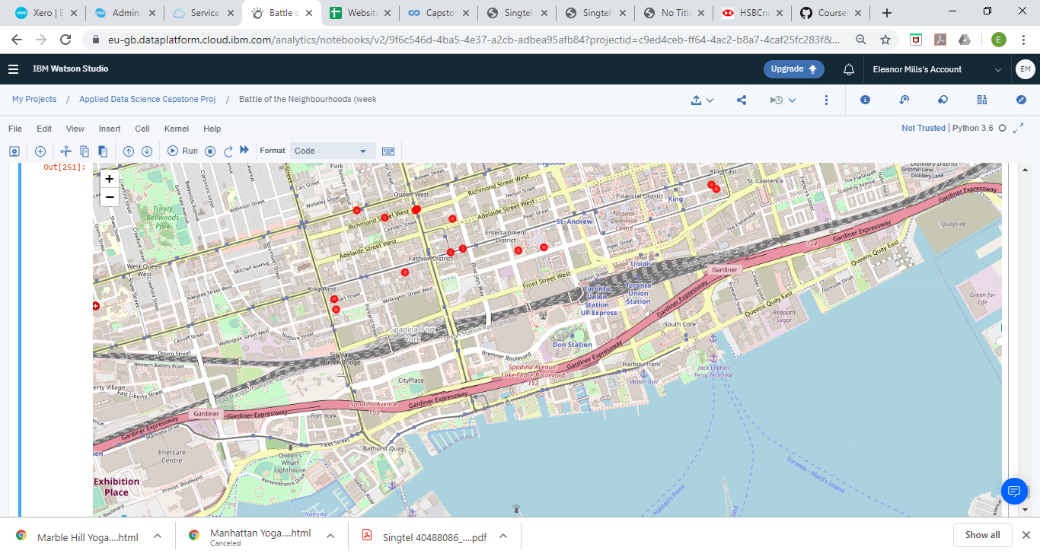
conclusion
Recommendation made to open the new studio here:
There are 2 Tennis Courts located there but currently no Yoga Studio. It is also close to transport links – main road and railway station.

